Slide 1
North Hartford Ascend Pipeline Funded by the U.S. Department of Education
October 18, 2023
L
Notes:
Luz
Good evening and welcome to the North Hartford Ascend Pipeline Community Conversations. My name is Luz Holmes, Ascend Community Partner.

Slide 2
This meeting is being recorded and the recording will be posted on the Connecticut Children’s website.
L
Notes:
We ask that guests remain muted during the presentation. Please submit comments or questions in the chat and we will facilitate a Q&A after the presentation.

Slide 3
Por favor recuerde seleccionar su lenguaje en el globo de la parte inferior de su pantalla para interpretación Desde su celular, toque los 3 puntos y seleccione su lenguaje.
Please remember to select your language on the globe at the bottom of your screen for simultaneous interpretation. From your cell phone, touch the 3 dots and select your language.
L
Notes:
We ask that guests remain muted during the presentation. Please submit comments or questions in the chat and we will facilitate a Q&A after the presentation.

Slide 4
Incentive Available to Hartford Residents
L
Notes:
https://forms.gle/q7KQxRQGHbqcYiJT7

Slide 5
Discussion Guidelines
Everyone deserves to be heard.
Online: Turn your camera on (we would love to see you), and keep your mic muted unless you’re speaking.
Don’t be afraid to use the chat!
Listen and respond respectfully.
Let’s stay on topic– time is limited, so let’s value each other’s time.
Successful dialogue is the responsibility of all participants.
L
Notes:
**Please keep in mind this is a brainstorming session, not everything said will be implemented etc.**

Slide 6
Agenda
Welcome & Guidelines
Ascend Announcements
Ascend Overview
September Community Conversations Questions
Get Involved
Provider & Partner Engagement
Next Steps and Closing Remarks
November 15th Meeting: In-Person featuring the Office of Family and Community Partnerships at Hartford Public Schools
L

Slide 7
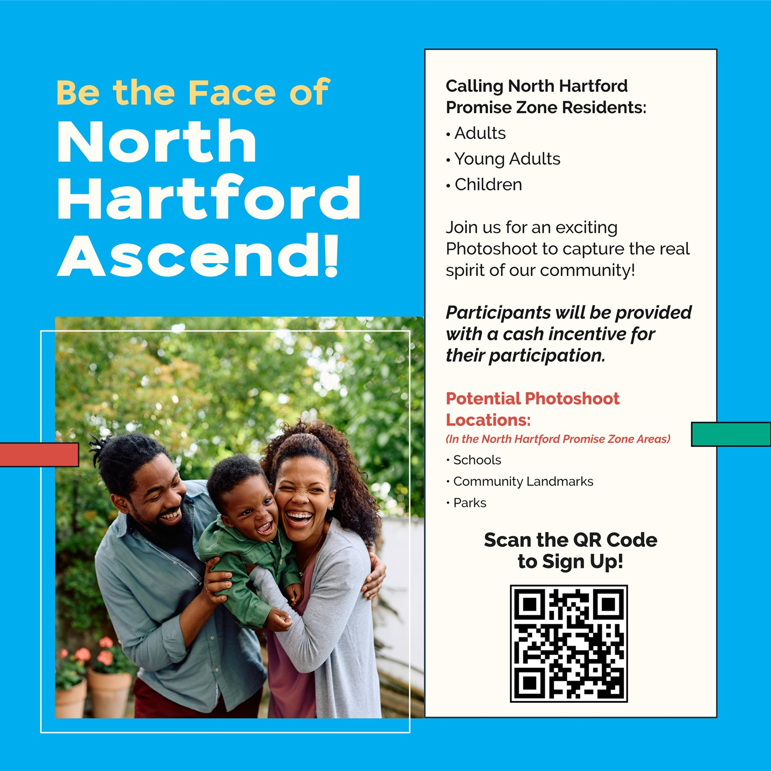
Ascend Announcements: FourteenG
L

Slide 8
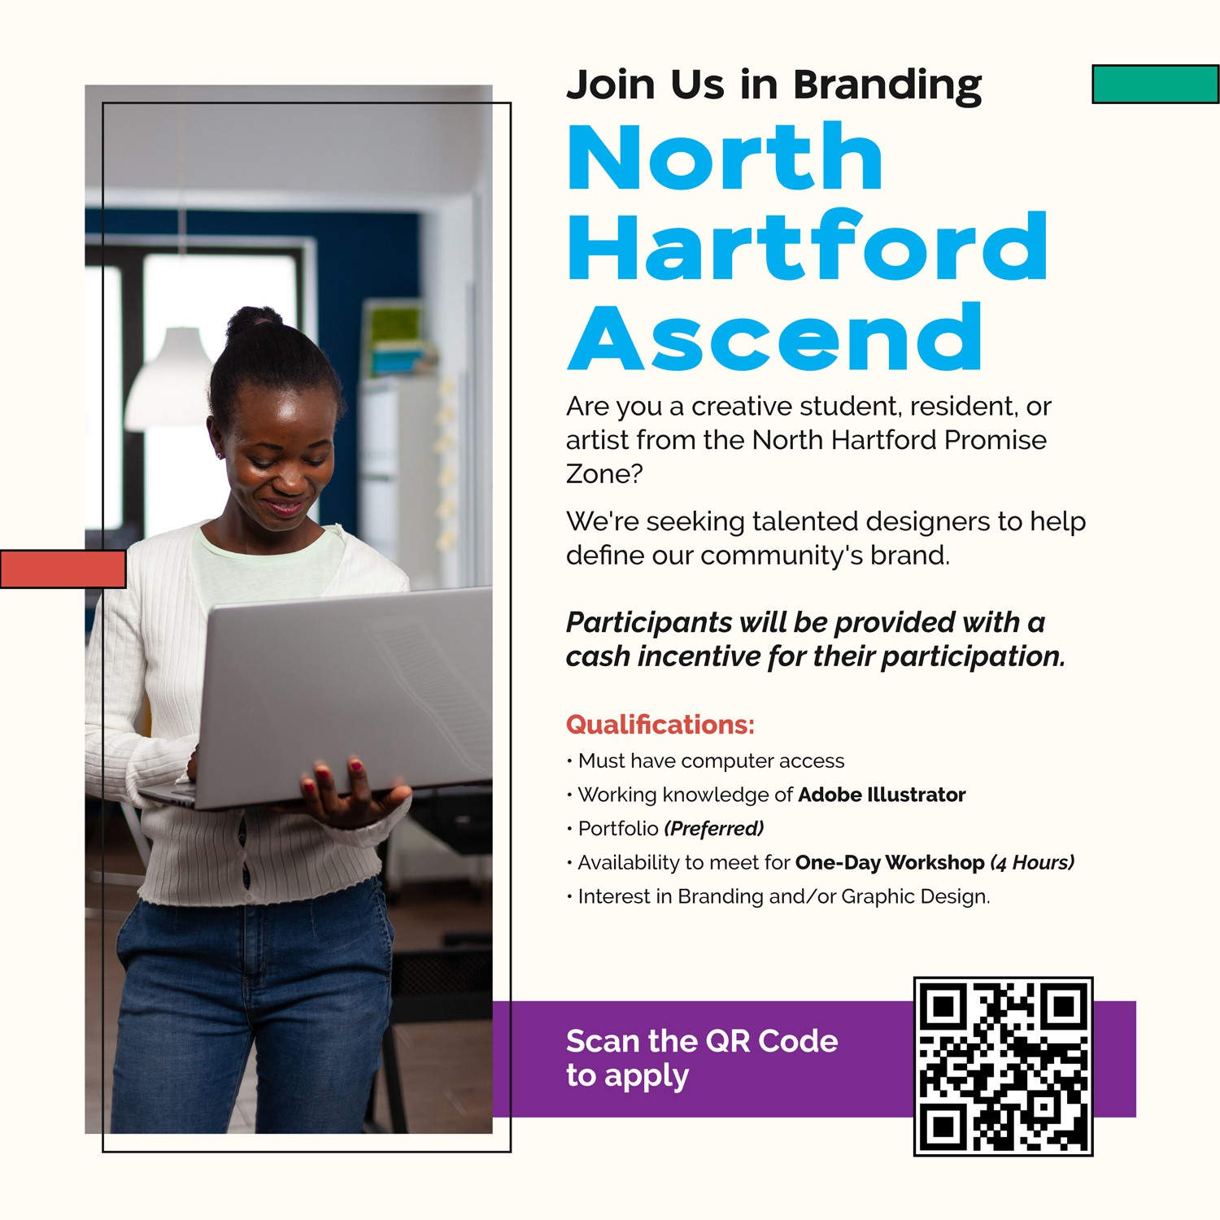
L
Notes:
https://northendascend.com/community-branding/

Slide 9
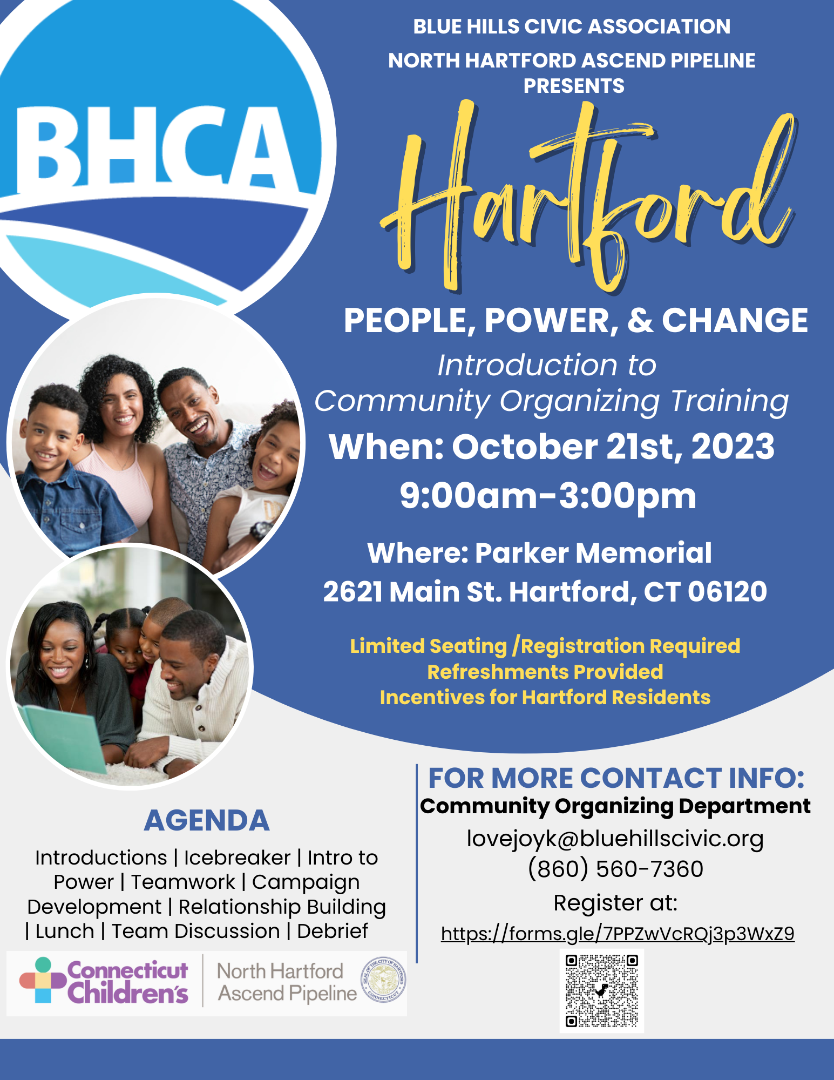
Ascend Community Workshops
L

Slide 10
North Hartford Ascend Pipeline
C
Notes:
Michelle Transition to Courtenay

Slide 11
Purpose
Ascend provides access to children and
families to the services and supports they need to reach their full potential from
Cradle to Career.
C

Slide 12
Ideal State-Ascend System Building
Care Coordinators
WIC Staff
Career Navigators
Family & Community Support Services Providers
Community Health Workers
Home Visitors
211 Child Development
Care Navigators
Funding to Address Gaps & Capacity Issues
Opinions, Priorities, Concerns, Needs of Promise Zone Neighborhoods’ Residents and Families
North
Hartford
Ascend Pipeline
Programs, Services, Supports of Strong Community-Based Organizations in Promise Zone Neighborhoods
COMMUNITY VOICE AND CO-PRODUCTION
C
Notes:
2 of a 5 year initiative and that much of our work to date has focused on planning, structure, and processes. We appreciate the need for action and outcomes- these will increasingly come.

Slide 13
September Community Conversations Questions
What does Ascend do?
How is Ascend helping strengthen community organizations?
What resources does Ascend provide to strengthen advocacy and leadership skills?
How can the community know more about current Ascend activities?
Who are Ascend partners and providers?
How does a group join Ascend?
Notes:
Questions have been asked in September Community Conversation, in feedback surveys, and by community members in person.

Slide 14
Community Question:
What does Ascend do?
C
Notes:
There’s been a lot of conversation about what Ascend IS, but it might be helpful to think about what Ascend DOES instead.

Slide 15
What does Ascend do?
Ascend DOES
1. Create easy pathways for families to access services
Care Navigators such as HPS FCSSPs and The Village Family Navigators help connect families to resources
2. Bring Hartford programs and services together
Improved collaboration among providers means an easier transition between services
Communication reveals what community needs are not being met so partners can work to address them
3. Strengthen Hartford programs and services
Community feedback on improvement areas goes directly to providers
Possibly provide funding to help solve issues and close gaps
Capacity building and training

Slide 16
Community Question:
What resources does Ascend provide to strengthen advocacy and leadership skills?
T

Slide 17
Community Skill Building
Ascend Community Workshops - opportunities for residents to build skills and learn strategies to become effective community leaders.
CTData Collaborative offered How to Interpret, Access, & Use Hartford Data
on Thursday, October 12th
Blue Hills Civic Association presents People, Power, & Change: Introduction
to Community Organizing on Saturday, October 21st at Parker Memorial
Upcoming workshops from Advocacy to Legacy, Leadership
Greater Hartford, and more to come!
Have an idea for a presenter or request for a workshop topic?
Contact amcginty@unitedwayinc.org
T
Notes:
There are organizations working to create change and address systems level issues, including FACES/SGCs, NHTAC, and others.

Slide 18
Community Question:
How can the community know more about current Ascend activities?
T

Slide 19
Current Ascend Outreach Activities
Community Representatives and Resident & Community Advisory Group members are direct connections to Ascend embedded within the community.
Upcoming newsletter will plan to share updates from Ascend workgroups on current activities and future plans.
Outreach and tabling - invite us to your event!
Social Media - Like Us on Facebook at North Hartford Ascend
Ask here! We hope to provide more opportunities to answer the questions you have about Ascend in Community Conversations and beyond.
A

Slide 20
Community Question:
How will Ascend help strengthen community organizations?
C

Slide 21
Strengthening Community Organizations
Feedback from the community is used to improve programs and services
Resident Community Advisory Group members collect and share community perspectives
Share your thoughts in the open Community Feedback and Ideas Form at any time
Bring ideas to these Community Conversations
CBO Capacity Building - Ascend partners will be provided a professional development opportunity to build community engagement skills.

Slide 22
Community Question:
Who are Ascend partners and providers?
How does a group join Ascend?
C

Slide 23
Ascend Partners & Programs
City of Hartford
Community First School
Community Health Services
Connecticut Children’s
CT Data Collaborative
FourteenG
Hartford Health Initiative
Hartford Promise
Hartford Public Schools
Intercommunity Health Care
San Juan Center
The Children’s Museum
The Village for Families & Children
UConn Health Center
United Way of Central and Northeastern Connecticut
United Way of Connecticut
University of Hartford Center for Social Research

Slide 24
Discussion Questions
What other questions do you have about Ascend?
Do you know how to contact Ascend to provide feedback?
What would you like to know that wasn’t shared today?
If we had a brick & Mortar location where would you like that to be?
When individuals are looking for information, resources, such as housing, childcare, etc. where is that information obtain
L
Notes:
General discussion, not breakouts.

Slide 25
Thank You!
Upcoming meeting: Wednesday, November 15th at 6pm IN-PERSON location TBC
Are you interested in facilitating or taking notes during future Community Conversation breakout groups? Contact Ally McGinty at amcginty@unitedwayinc.org to sign up for the Facilitating and Note-taking Workshop.
Please take the Post Meeting Feedback & Incentive Survey to share your thoughts and feedback. An incentive is available to Hartford community members participating in this meeting. The link is posted in the chat and will be sent out via email. Contact Ally McGinty at amcginty@unitedwayinc.org with any questions.
Feedback or questions? Contact nhap@connecticutchildrens.org.
L

Slide 26
Current State
Strong Array of Programs, Services, Supports of Community-Based Organizations in Promise Zone Neighborhoods
Opinions, Priorities, Concerns, Needs of Promise Zone Neighborhoods’ Residents and Families
C

Slide 27
U.S. DOE Promise Neighborhood Program Results
Students. . . .
Enter kindergarten ready to succeed in school.
Are proficient in Math and English Language Arts.
Successfully transition from middle to high school.
Graduate from high school.
Obtain post-secondary degrees, certifications, or credentials.
Are supported by families and communities in their learning.
Are healthy.
Feel safe at school and in the community.
Live in stable communities.
Have access to 21st century learning tools.
C

Slide 28
Program Name
People served & Outcomes
How many people does the program serve overall and in the Promise Zone neighborhoods (if data is available)
What have past recipients experienced
Eligibility
Notes:
Percent of Promise Zone (PZ) reached?

Slide 29
Program Name
How to get connected
If more info is available, add websites, QR codes, etc to this slide
What to expect after initial encounter
How to reach program

